Slide 1

Liquid Hydrogen Storage

Slide 2
Team Protium
Presents to You
Simulation of Hydrogen Tank in Ansys
Vishwjeetsinh Jadeja
B22MT023
b22mt023@iitj.ac.in
Sahil
B22MT038
b22mt038@iitj.ac.in
Aaditya Kamble
B22MT024
b22mt024@iitj.ac.in

Slide 3
What is Hydrogen ?
Hydrogen, is the lightest and most abundant element in the universe, exhibits unique properties when in its liquid state. Liquid hydrogen is produced through cryogenic liquefaction. Liquid hydrogen is a key component in rocket propulsion due to its high energy content and efficiency. It has been used in various space missions, powering rockets and serving as a crucial element in the exploration of outer space. While hydrogen itself is not toxic, it is highly flammable, demanding strict safety protocols in storage and transportation.

Slide 4

Liquid hydrogen is the cryogenic state of the chemical element hydrogen (H2).
At standard atmospheric pressure, hydrogen exists as a gas.
Still, when cooled to very low temperatures, it undergoes a phase transition and becomes a colorless, odorless, and highly flammable liquid.
The change from gaseous to liquid hydrogen occurs at its boiling point, approximately -252.87 degrees Celsius.
Liquid Hydrogen
It's important to note that the handling and storage of liquid hydrogen require specialized equipment and safety precautions due to its extremely cold temperature and flammability. Proper safety measures are crucial when working with this cryogenic substance.

Slide 5
Liquid Hydrogen Storage
The cryogenic hydrogen is to be stored in specially insulated vessels at (-) 252.880C.The energy required to liquefy hydrogen (gas at 300oK and 1 bar pressure) is about 47 MJ / kg of hydrogen.
Cryogenic Storage
Liquid hydrogen is stored in cryogenic tanks at 21.2 K at ambient pressure. Because of the low critical temperature of hydrogen (33 K), the liquid form can only be stored in open systems, as there is no liquid phase
existent above the critical temperature.

Slide 6
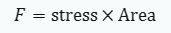
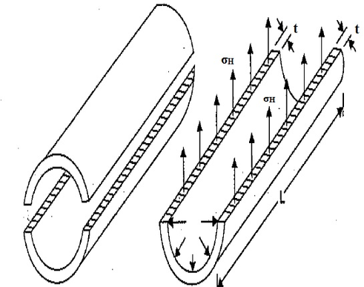
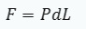
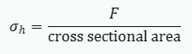
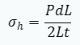
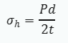
Pressure Vessel
Hoop Stress/ Circumferential Stress
total force developed by the pressure P,
Hoop stress is given by,
Assuming thin pressure vessel

Slide 7
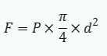
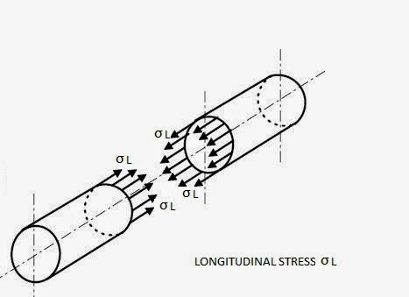
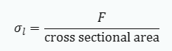
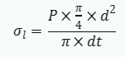
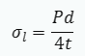
Longitudinal Stress
total force developed by the pressure P,
Longitudinal stress is given by,
Assuming thin pressure vessel

Slide 8
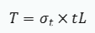
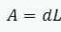
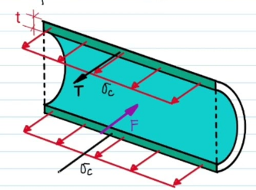
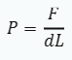
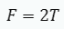
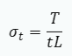
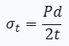
Tangential Stress
Area of rectangle,
pressure can be given as,
Net force along x direction is zero,
-->
Assuming thin pressure vessel

Slide 9
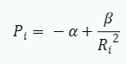
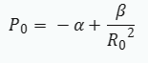


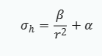
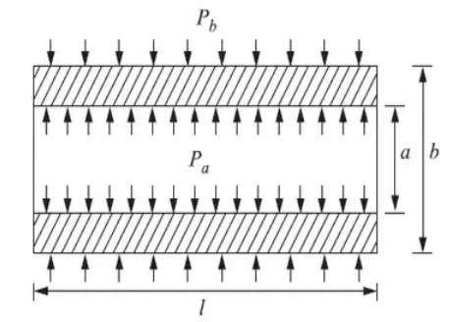
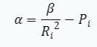


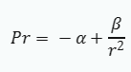
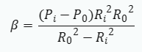


Thick Pressure Vessels
Using eq. 2 to find α and β,
at, r = Rᵢ and P = Pᵢ
at, r = Rᵢ and P = Pᵢ
Lame’s Equations:
Hoop stress (σₕ)
Solving 3 and 4:
Pressure at any r:
Where α and β are Lamé’s constants

Slide 10
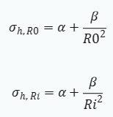
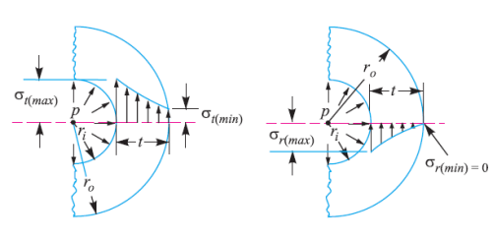

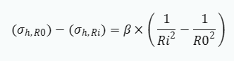
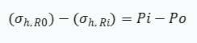
at r = Rᵢ and r = Rₒ,
Case 1: Only external pressure, Pi = 0:
Substracting them,
using eq. 6,
Radial and hoop stress
distribution
*

Slide 11
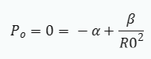
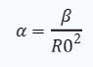
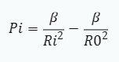
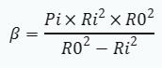
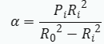
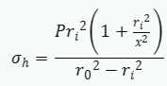
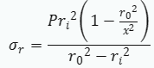
Case 2: Only internal pressure, Pₒ = 0
-->
ₕ
ₕ
Putting it in Pᵢ,
Radial and hoop stress distribution
and
putting it in 1 and 2 :

Slide 12
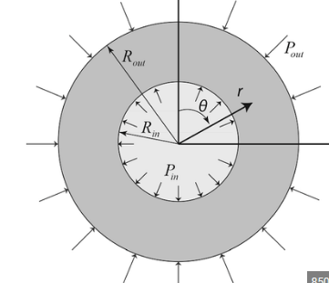
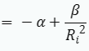

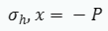
Case 3: Pi = Pₒ=P:
β = 0 and P = -α
Independent of radius and
constant through out radius

Slide 13
PARAMETERS CONSIDERING FOR DESIGN
Circumferential or Hoop Stress :
Hoop stress resists internal pressure, analyzed in cylinder equilibrium. It's the circumferential force on particles, perpendicular to the axis and radius. Excess stress may split the pipe, allowing failure along any diameter-axis plane. Elements resisting this are stressed along the circumference.
Longitudinal Stress:
A closed-ended cylinder containing fluid under gauge pressure experiences both longitudinal and circumferential stresses in its walls. Under internal pressure 'P,' the pipe may fail, with elements resisting this failure subjected to stress parallel to the longitudinal direction.
Radial stress:
Radial stress can also be a factor in thick-walled pipe. It is stress in directions coplanar with, but perpendicular to, the symmetry axis. The radial stress is equal and opposite to the gauge pressure on the inside surface, and zero on the outside surface.

Slide 14
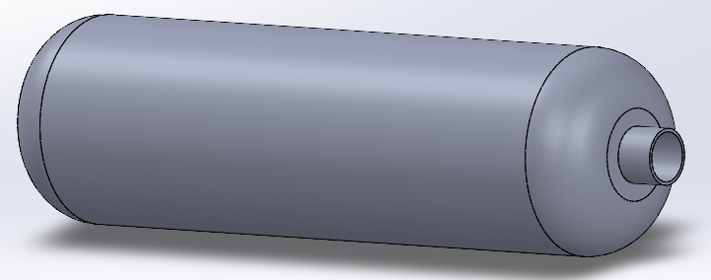
Length - 8270mm
Thickness - 39mm
Diameter - 2300mm
Pressure - 35MPa
Designing of Hydrogen Storage Tank
We made this pressure vessel shown above with the mentioned dimensions

Slide 15
Internal Pressure - 35MPa
Simulation
conditions
Environment Temperature - -250C
One fixed support at the mouth of this vessel
Materials Used:
Structural Steel
Magnesium
AL7075-T6 (Aluminium alloy)
Ti-6Al-4V (Titanium alloy)

Slide 16
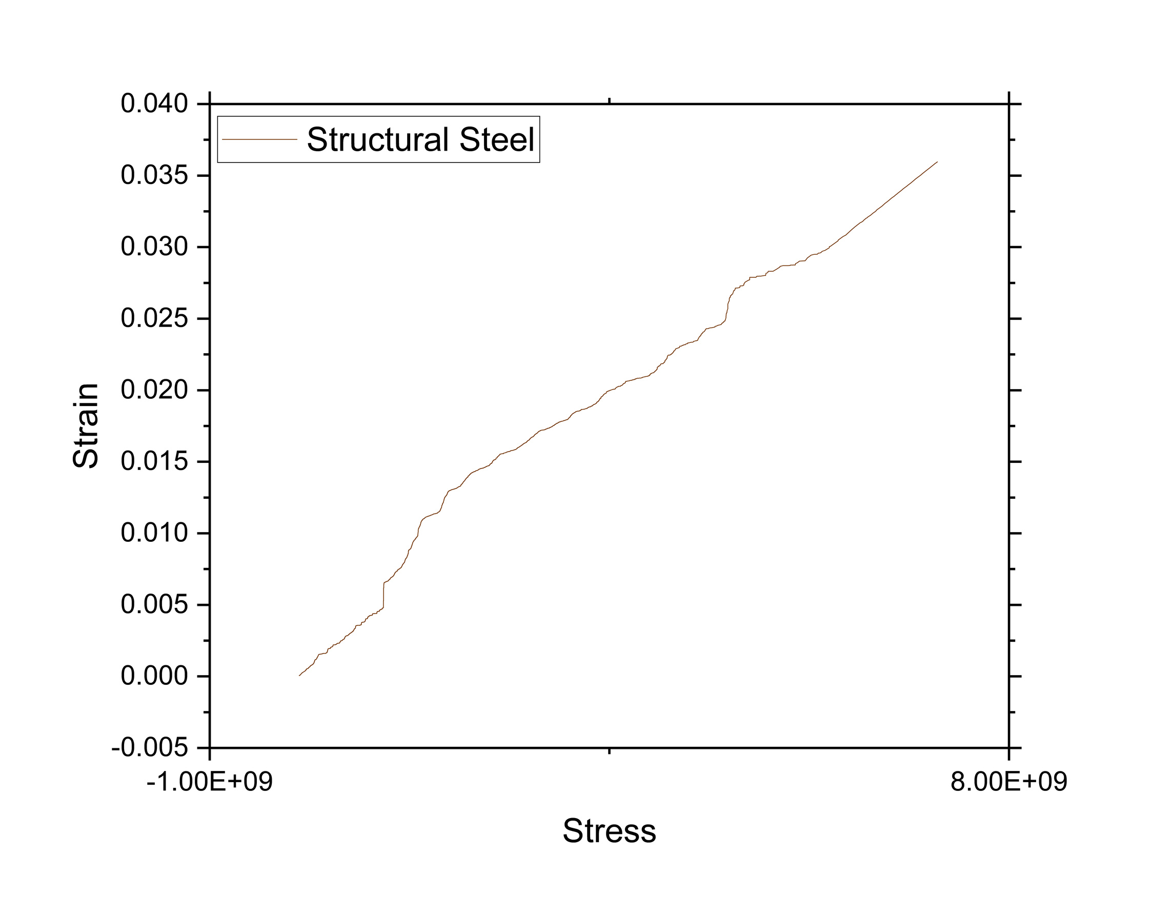
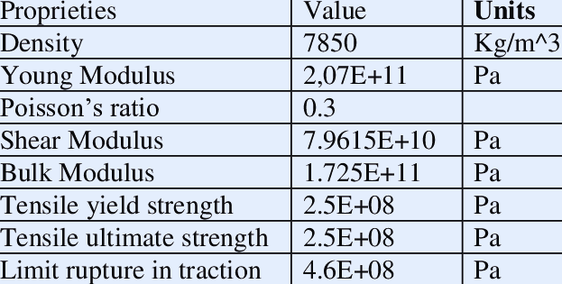
Structural Steel

Slide 17
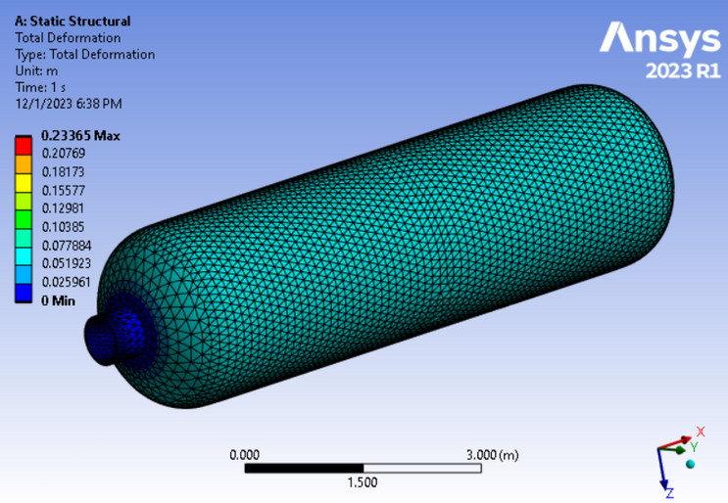
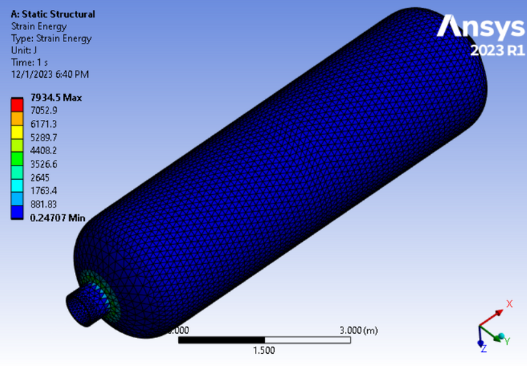
Structural Steel
Deformatation
Strain Energy
Shows maximum deformation of 0.23365 m
Maximum strain energy came out as 7934.5 J

Slide 18
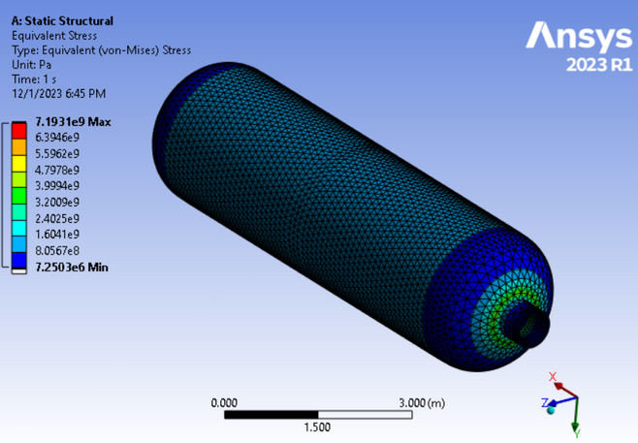
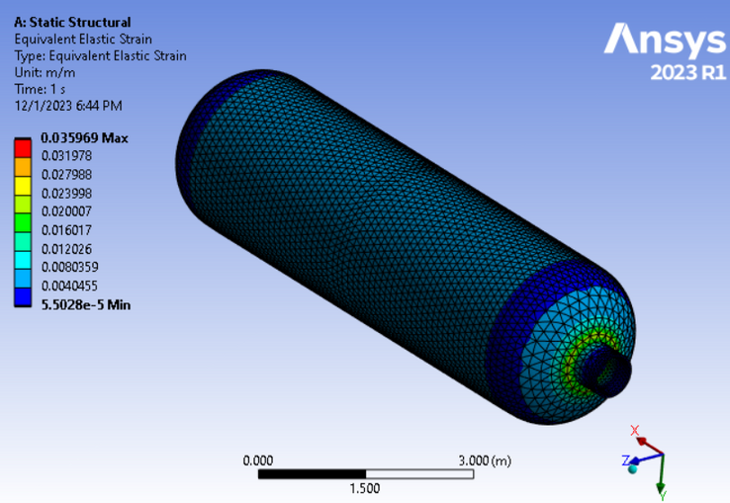
Structural Steel
Stress
Strain
The maximum stress experienced by the material is 7.1931e9 Pa
The maximum strain experienced is 0.035969.

Slide 19
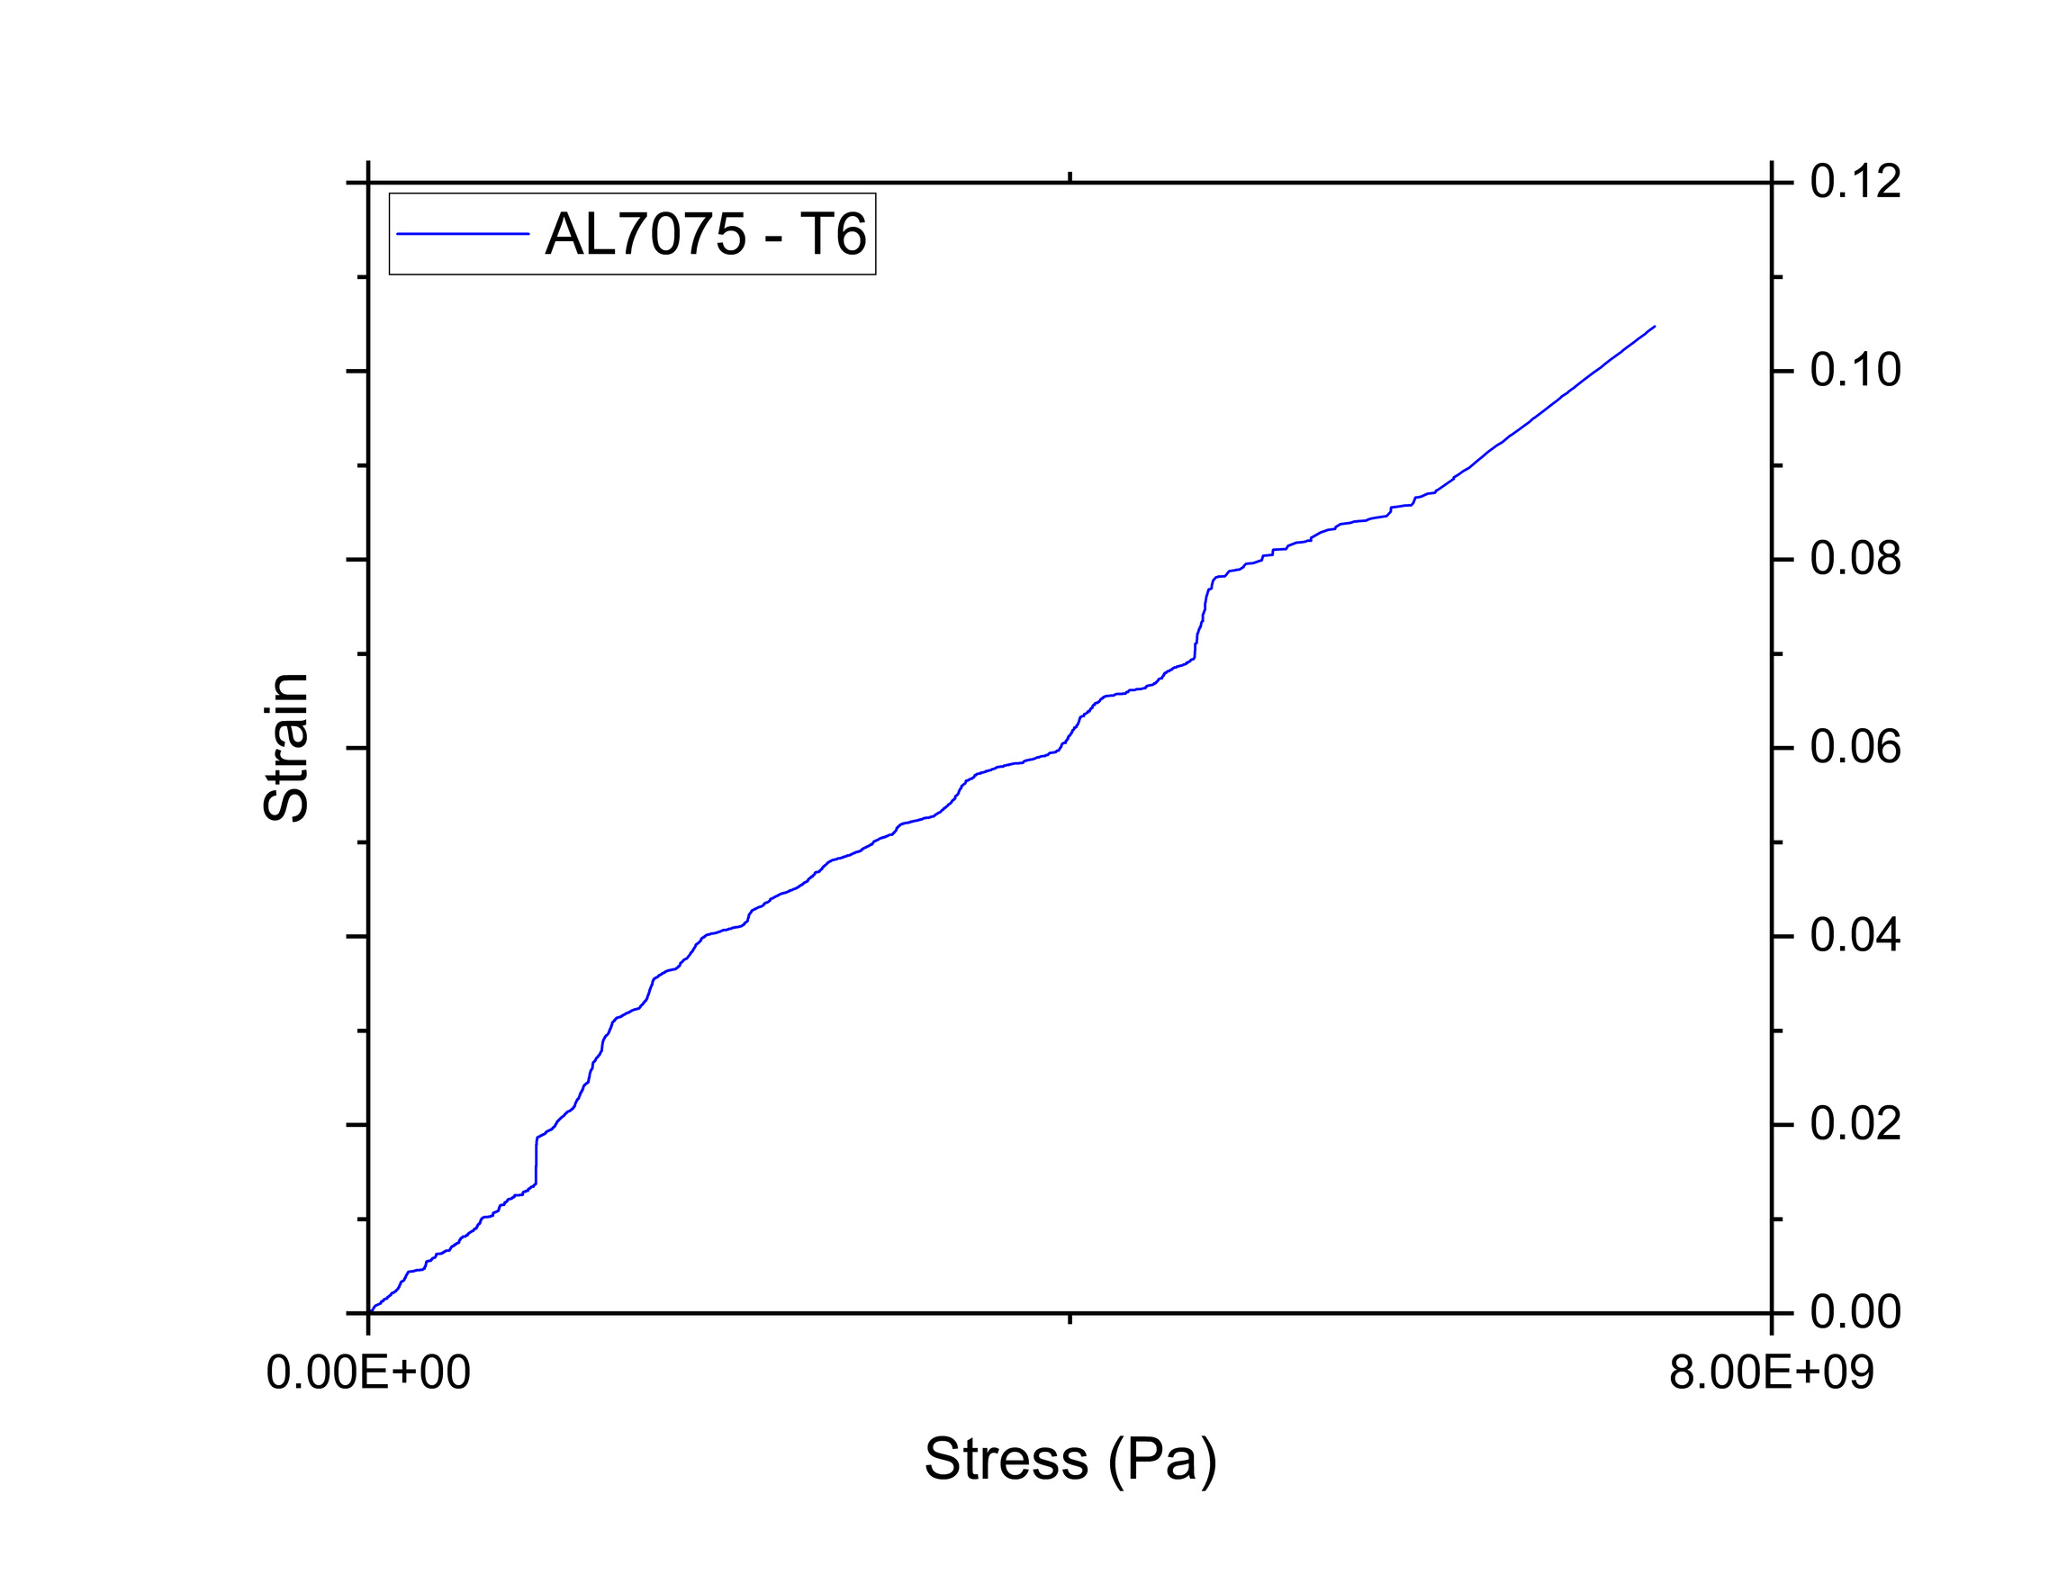
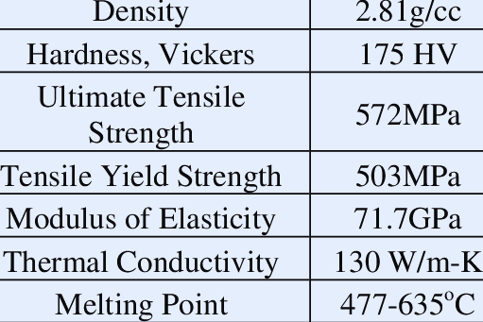
AL7075-T6 :
Aluminium Alloy

Slide 20
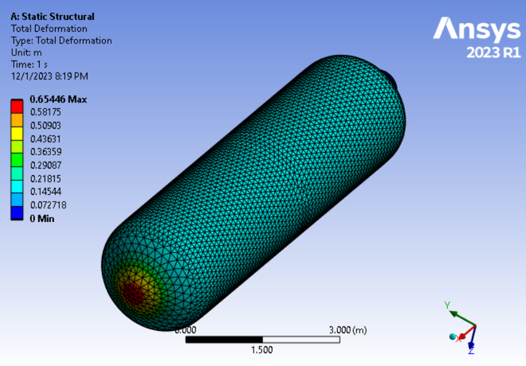
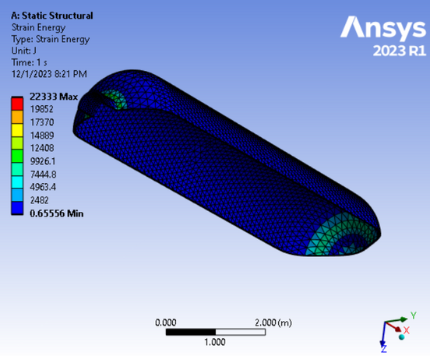
AL7075-T6 : Aluminium Alloy
Deformatation
Strain Energy
Shows maximum deformation of 0.65446 m
Maximum strain energy came out as 22333 J

Slide 21


AL7075-T6: Aluminium Alloy
Stress
Strain
The maximum stress experienced by the material is 7.3332e9 Pa
The maximum strain experienced is 0.10477.

Slide 22


Ti-6Al-4V :
Titanium Alloy

Slide 23


Ti-6Al-4V : Titanium Alloy
Deformatation
Strain Energy
Shows maximum deformation of 11.537 m
Maximum strain energy came out as 5.6862e5 J

Slide 24


Ti-6Al-4V : Titanium Alloy
Stress
Strain
The maximum stress experienced by the material is 4.2923e9 Pa
The maximum strain experienced is 0.040141.

Slide 25


Magnesium

Slide 26


Magnesium
Deformatation
Strain Energy
Shows maximum deformation of 1.0749 m
Maximum strain energy came out as 36782 J

Slide 27


Magnesium
Stress
Strain
The maximum stress experienced by the material is 7.4261e9 Pa
The maximum strain experienced is 0.17683.

Slide 28

Strain Plot
Peak values of strain:
AL7075-T6: 0.10477
Magnesium: 0.17683
Structural Steel: 0.035969
Ti-6Al-4V : 0.040141

Slide 29

Stress Plot
Peak values of strain:
AL7075-T6: 7.3332e9 Pa
Magnesium: 7.4261e9 Pa
Structural Steel: 7.1931e9 Pa
Ti-6Al-4V : 4.2923e9 Pa

Slide 30

Strain Energy
Peak values of strain:
AL7075-T6: 22333 J
Magnesium: 36782 J
Structural Steel: 7934.5 J
Ti-6Al-4V : 5.6862e5 J

Slide 31

Deformation
Peak values of strain:
AL7075-T6: 0.65446 m
Magnesium: 1.0749 m
Structural Steel: 0.23365 m
Ti-6Al-4V : 11.537 m

Slide 32
Thank You
Team Protium

